Slide 1



Why Axis Group Lab 2
Nandini
Kelly
Chad
Raji

Slide 2
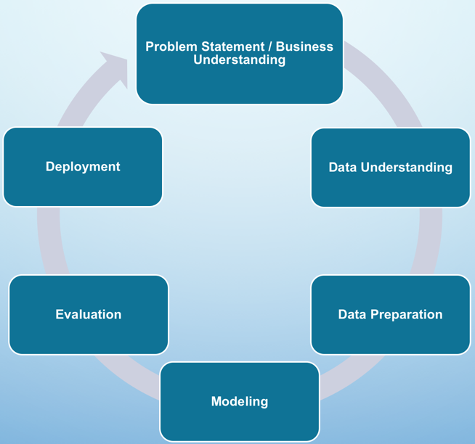
Project Approach
Methods, Practices:
Problem Statement / Business Understanding
How team divides & conquers:
Tax data
Data Understanding
Determine which Data
Determine which Columns
Data Preparation
Formatting / Data type conversion before merge
Clean data after merge (most – NaN, duplicates), except dates
Future
Methodology: CRISP-DM
GDP data
Review Lab description together and gain common understanding
Modeling
Experiment with visualizations
Communication: Rocket.Chat
Dev Platform: Local (not Amazon Workspace)
GitHub.com
Well-documented notebooks
Presentation
Visuals
Review feedback

Slide 3

Why Axis Feedback
continue Solid presentation style with visuals
Yes, look at more unique analysis - tax dist, land use neighborhood, school dist - continue down that path
Multiple charts (Like Land Use, Sale chart) – Continue use of system of visuals to add context (ex., what land use code looks like across counties; How sale price impacted)
Continue TO tighten presentation.
Continue with consistent data (ex., Franklin county)
Focus on making presentation story style, with house and looking at outliers. Get more answers and more story put around those items.
(Nandini question) - OK to use median (or interpreted value) vs. default value, yes

Slide 4
Problem Statements
How does (or does) GDP (Gross Domestic Product)* impact housing sales in the Columbus Metropolitan Statistical area over time?
How do tax increases impact the sales in Franklin County over time?
* Gross Domestic Product (GDP) is the total monetary or market value of all the finished goods and services produced within a specified border in a specific time period. As a broad measure of overall domestic production, it functions as a comprehensive scorecard of the specified area’s economic health.

Slide 5
Data Understanding
Clean data
Merge
Merge updated Franklin data with all_data
Which Data
all_data from Group Project 1 (not Madison / Morrow
Rename unnamed columns in GDP data
Reformat Franklin Data (see next slide)
GDP current & real data
Current Franklin County data*
Clean more
Details on slide 7-8
* Downloaded from Franklin County Auditor online Web Reporter

Slide 6
Franklin Data* Preparation
Column Name | Action | Column Name | Action
Legal Description | Consolidate into one column | City | Remove ‘ CITY’ and ‘ CORP’
Parcel Number | Remove hyphen | Zip code | Change to str
Finished Area | Consolidate into one column Filter > 0 | Address | Consolidate into one column
County | Added (=‘Franklin’) | Year Built, Finished Area, Sale Price, Neighborhood, Primary Land Use Code | Change to int data type
Baths | Combined full and half | Bedrooms | Fill nulls with 0
Owner | Consolidate into one column | Sale Price | Filter >0 and <1,500,000
Sale Price, Sale Date, Primary Land Use Code, Acres, Neighborhood | Remove rows with values NaN | Various | Rename to match other merged county data
*10% data was sampled

Slide 7
Data PREPARATION (GDP file)
Drop Columns
Modify
Postal, FIPS, Industry name
GDP * 1000
Filter
State = ‘OH’, but selectively chose counties 7 merged together
LineCode = 1 (GDP from all sources)
Create Mean Sales Price table
Details on next slide

Slide 8
Data PREPARATION (merged county file)
Filter
Check for NaN
Sale Price > 0 and < 1,500,000
Land Use, Bedrooms, Rooms: Fill with zeroes
Sale Price: Drop rows
Parcel Number (remove '-', '.')
Sale Date MM/DD/YYYY, datetime dtype
Finished Area, (‘,’, int dtype)
Formatting
Delete
Old Franklin data
Create Mean Sales Price table
Details on next slide

Slide 9
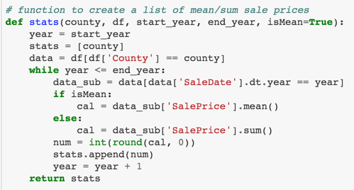
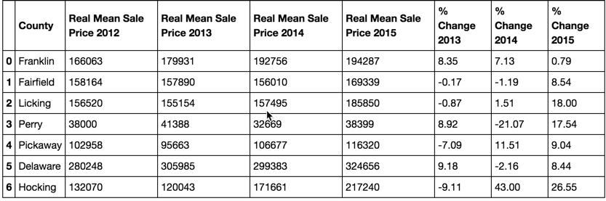
Mean Sale Price by Year per county
Adjusted for inflation
Round to whole numbers
Cast to int dtype
Rename columns
Calculate change from previous year * 100, round

Slide 10
Data Modeling
Trend 1
System of Visuals
Correlation
Trend 2

Slide 11
Median sales price and GDP by County
Problem Statement: How does (or does) GDP (Gross Domestic Product)* impact housing sales in the Columbus Metropolitan Statistical area over time?

Slide 12
What does this tell us?
Conclusion …

Slide 13
System of visuals slide… Tax/Area By School District?
Top District
3rd District
Observations:
2nd District
4th District

Slide 14
Up NExt
Additional data:
GIS data – Area?
School District / Tax (Licking, Morrow, Hocking, Franklin)
Neighborhood Codes
Additional Cleaning
Remove ValidSale = NO (ex., Morrow has NO for 100 rows)
Beautification of visualizations
formatting sales amounts
Enhancing views
Additional analysis
Which county has more sales of newer builds

Slide 15
APPENDIX

Slide 16
Data CHALLENGES
Data not complete
Data not aligned on dates
APPROACH: get data from county auditor site (Morrow, Madison, Franklin)
Extraneous, duplicate & split out columns
Ex., only 86 / 156 recs for Madison/Morrow
APPROACH:
Ex., Franklin was old <=2015
Missing / inconsistent data
Ex., Missing LandUse
APPROACH: Where column were present in most files, we kept and filled with NA
Combined (ex., TotalBaths, address fields)
Manual examination to determine which columns to ignore
Dropped (ex., unnamed:27)

Slide 17
Merged County Data preparation
Column Name | Action | Column Name | Action
All old Franklin data | Delete | Bedrooms | Fill nulls with 0
Parcel Number | Remove hyphen and period | Rooms | Fill nulls with 0
Finished Area | Remove commas, change to int data type | Sale Price | Fill nulls with 0 Filter >0 and <1,500,000
Land Use | Full nulls with 0 | Sale Date | Drop rows with nulls Consistent format Convert to datetime

